Slide 1

AIRLINES PASSENGER PREDICTION
AAKASH S.SHEDGE
ROLL NO : 902

Slide 2
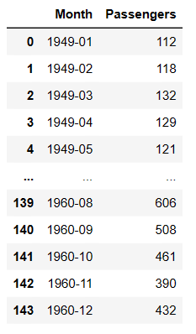
DATASET OF PASSENGER
THIS IS MONTHLY DATASET
FROM 1949/01/01 TO 1960/12/01

Slide 3
LINE PLOT DATASET HAVE UPWARD TREND AND SEASONALILTY IS PRESENT BY YEARLY.

Slide 4
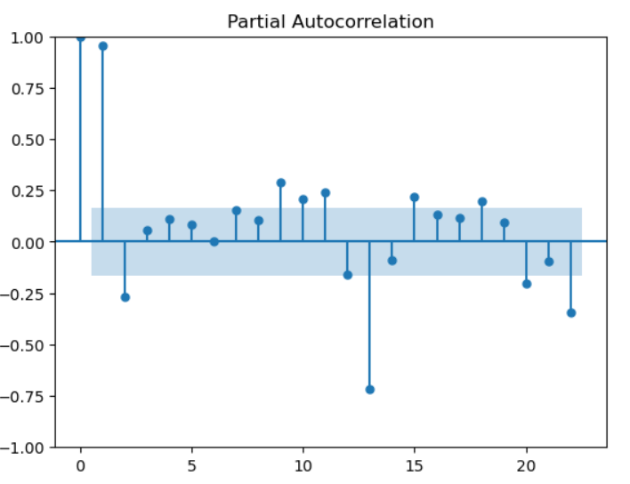
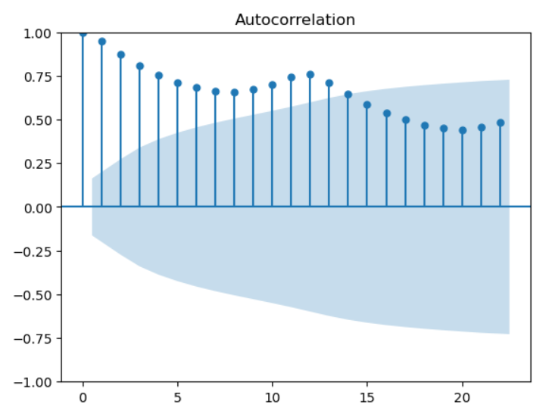
ADF TEST ON DATA
UNIT ROOT IS PRESENT IN THE DATASET

Slide 5
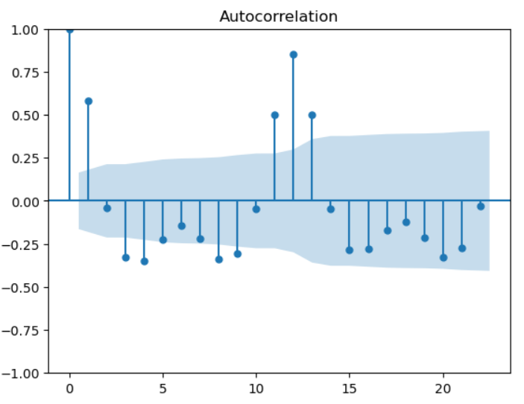
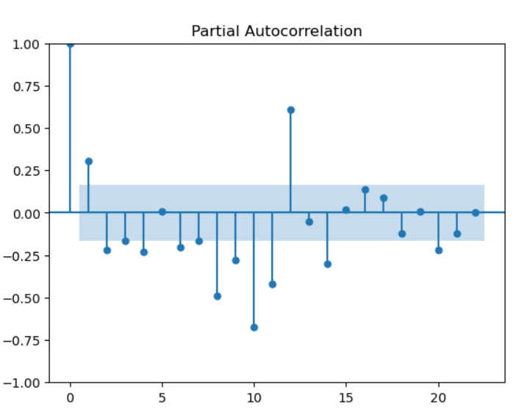
ADF TEST AFTER 1 DIFFERENCING

Slide 6
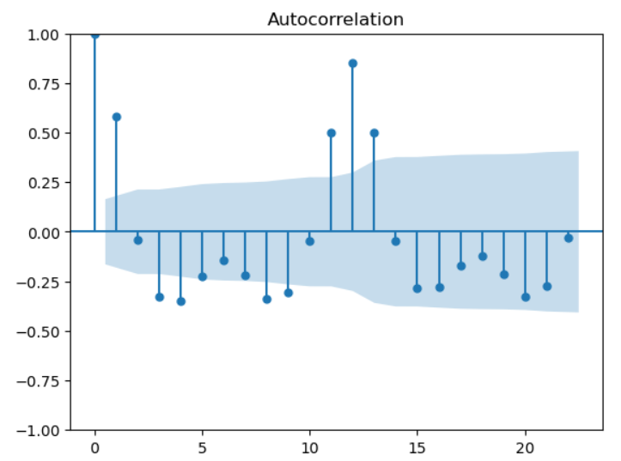
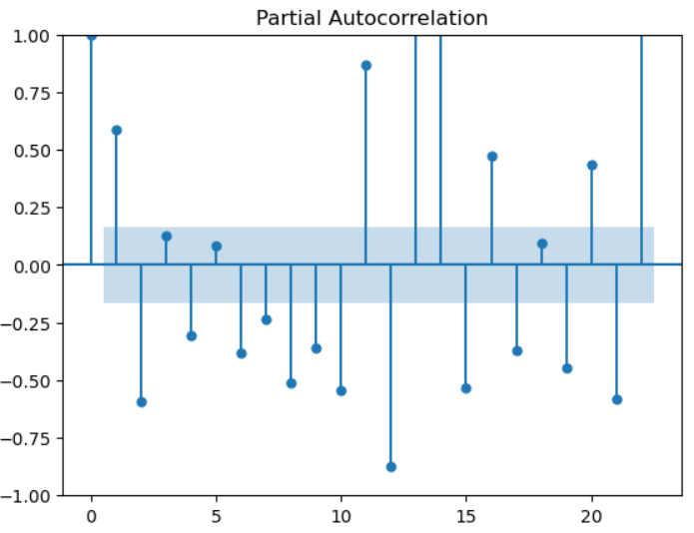
ADF TEST AFTER 2 DIFFERENCING

Slide 7
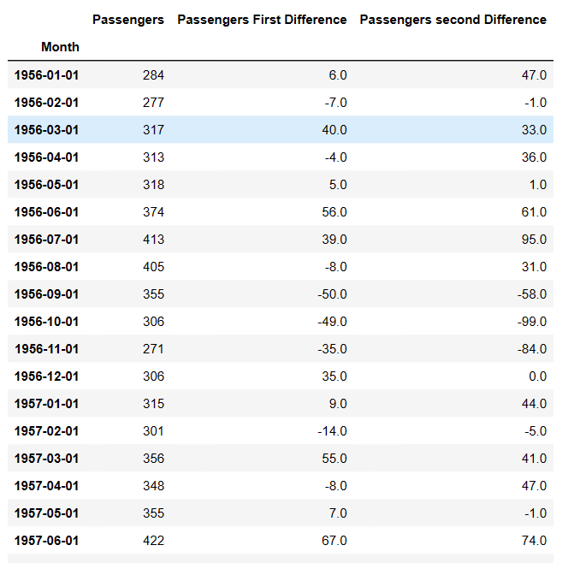
1ST AND 2ND DIFFERENCING DATASET

Slide 8
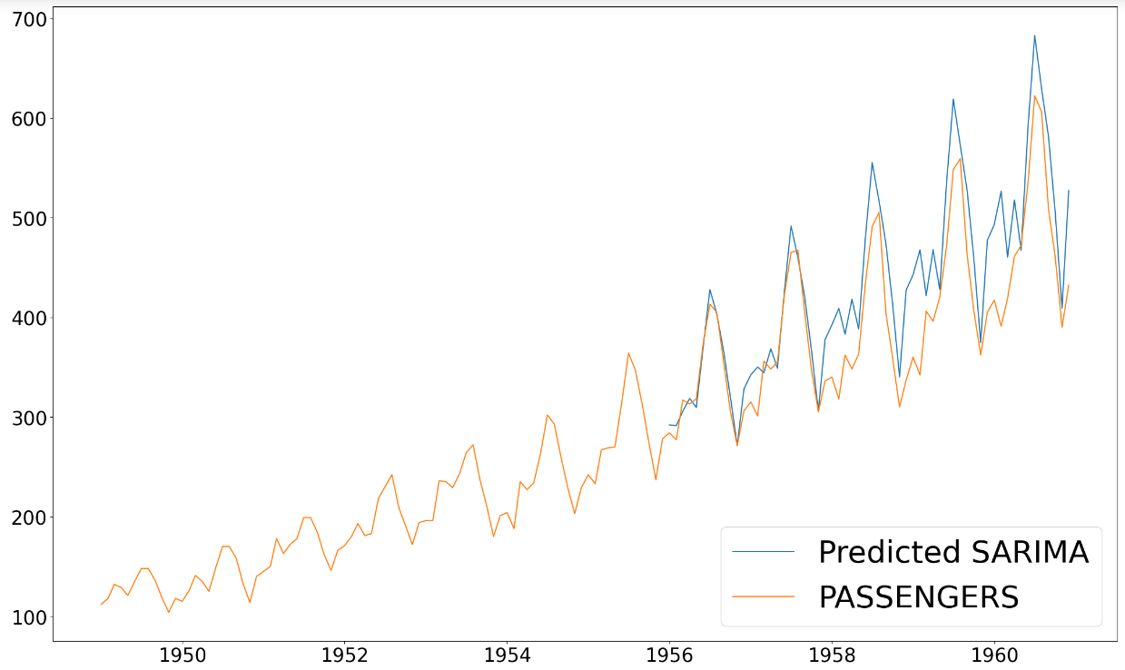
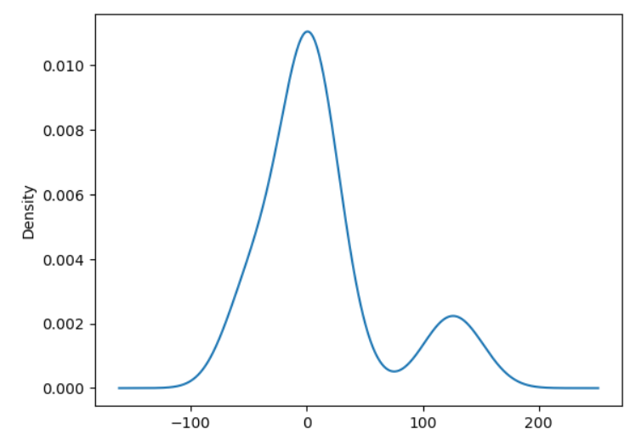

SARIMA MODEL WITH p =3 , d=2 , q=1 we go with sarima model because seasonality is present in dataset. At period 12

Slide 9
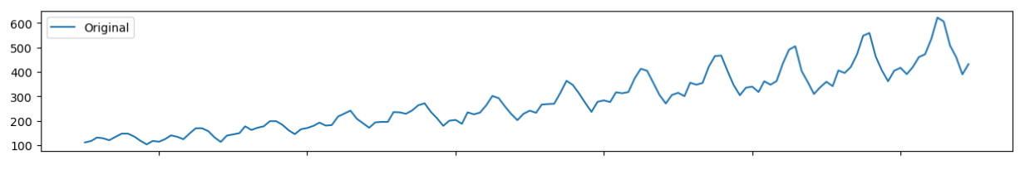
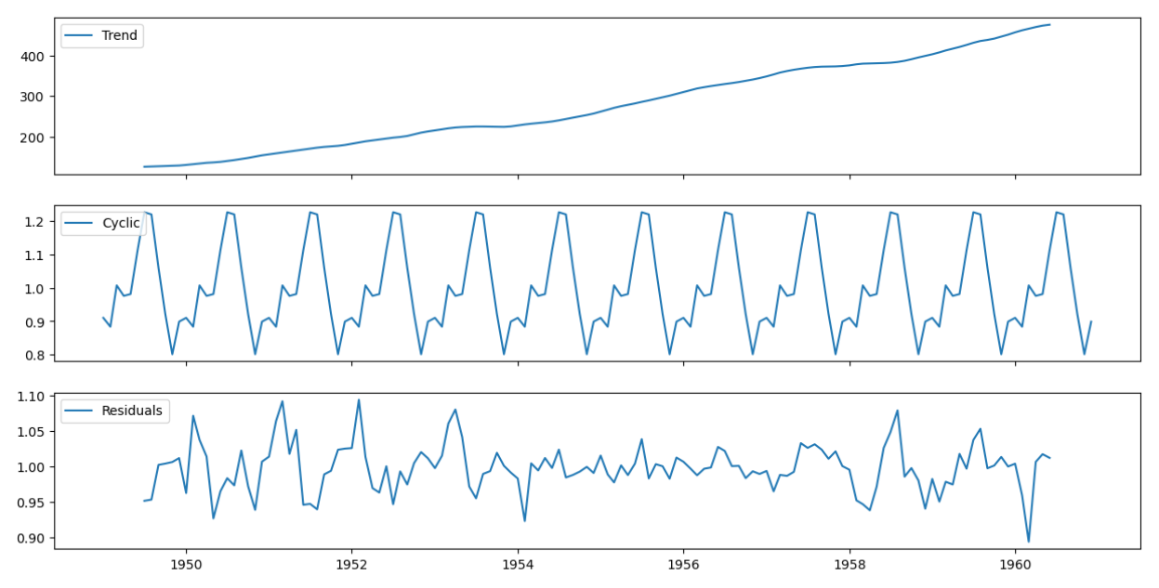
DECOMPOSITION

Slide 10
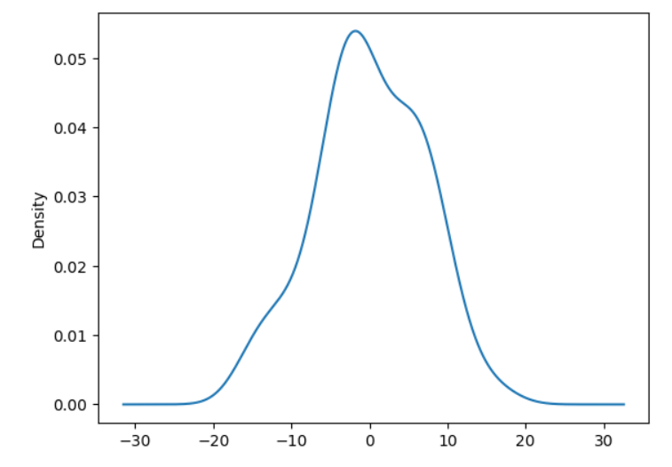
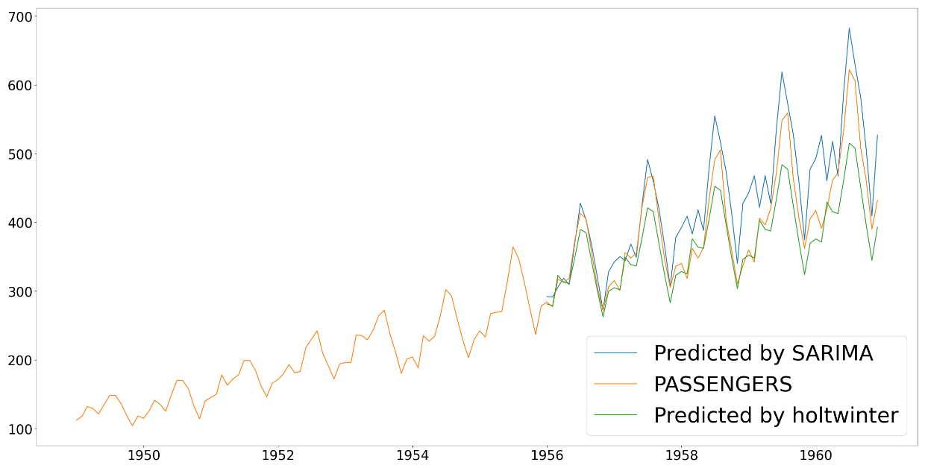

HOLTS-WINTER EXPONENTIAL SMOOTHING we use multiplicative method.

Slide 11
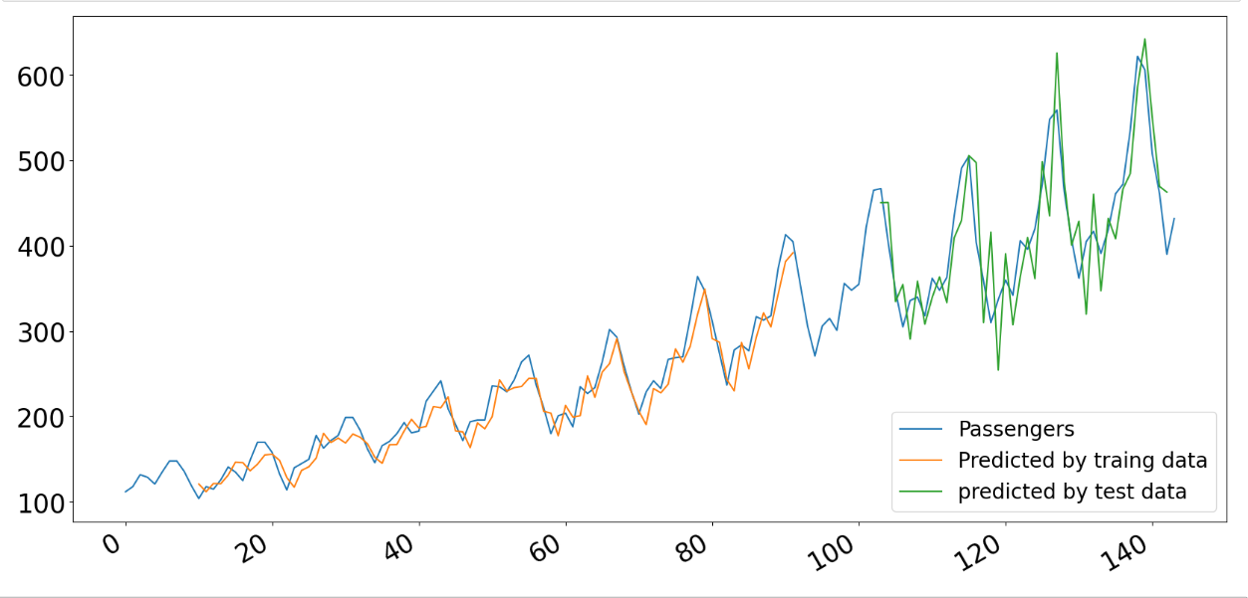
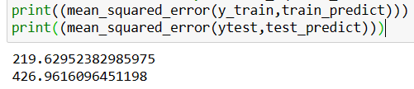
LSTM TIME STEP = 10

Slide 12
THANK YOU

